Slide 1
Influence Maps
Pattern-Based Solutions for Strategy

Slide 2
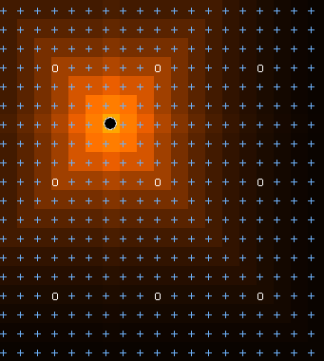
Influence Mapping
In strategic decisions, rather than trying to decide the most “rational” action by predicting behavior, it may be useful to base decisions on some set of approximations (heuristics) across a swath of terrain. One way to do so for complex terrain is to use influence maps.
Influence representations…
Break terrain into sections
Flood-fill “strength” into those sections
Are based on distance, reach, terrain, etc.
Can decay differently (linear, exp.)
Should terminate after a certain value
Don’t need to update each frame

Slide 3
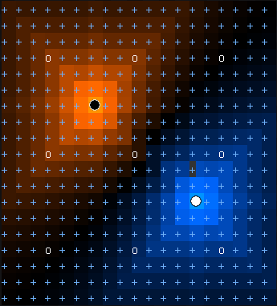
Influence Maps
It’s great to know our own strengths, but on its own this information isn’t useful – we must pair it with our (sometimes imperfect) knowledge of the opponent to get an influence map:
InfluenceMap = OurInfluence - EnemyInfluence
Our Influence
Influence Map

Slide 4
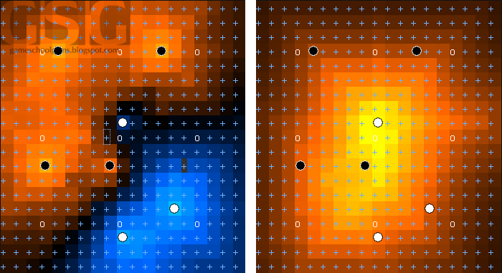
Influence Maps
Usually we pair information about our units with information about our opponent. We can then use this to create a tension map by summing the influences:
TensionMap = OurInfluence + EnemyInfluence
Influence Map
Tension Map

Slide 5
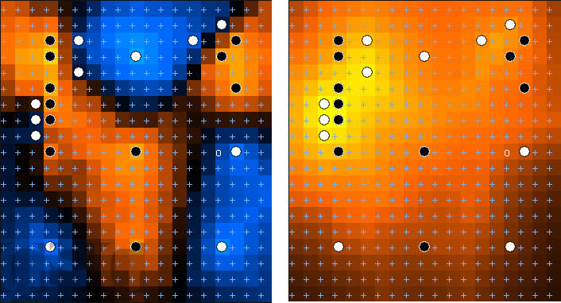
Influence Maps
Areas of high tension indicate locations where the most conflict is occurring. This is usually where our units can make the biggest difference.
Influence Map
Tension Map

Slide 6
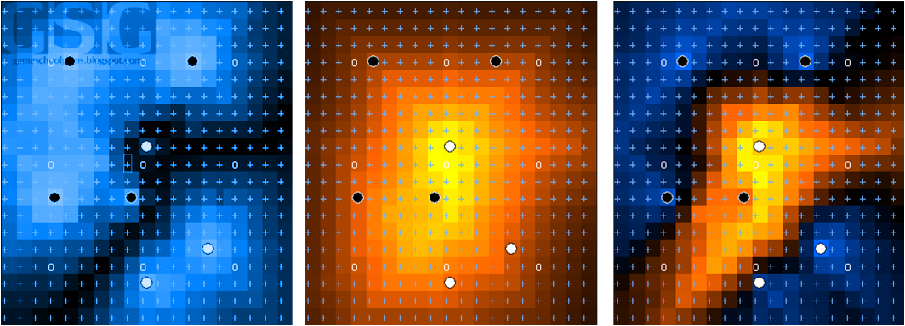
Influence Maps
It can also be useful to determine which areas of the map are most vulnerable by calculating a vulnerability map, which gives us an approximation of where on the terrain is in contention:
VulnerabilityMap = TensionMap – abs(InfluenceMap)
-abs(InfluenceMap)
Tension Map
Vulnerability Map

Slide 7
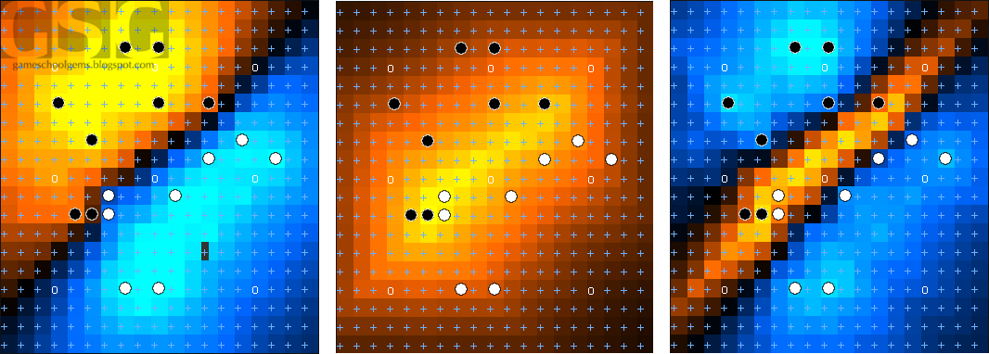
Influence Maps
We can use vulnerability maps to determine where our front lines truly are and react accordingly.
Influence Map
Tension Map
Vulnerability Map

Slide 8
Influence Maps Benefits & Drawbacks
Benefits
Provides good tactical awareness in complex RTS, FPS, and RPG games
Simple calculations that parallelize well (esp. for grid environments)
Can provide great historical information in some implementations
Drawbacks
Overkill for simple environments
Can use a lot of memory (and therefore also CPU)
For more information, see:
http://gameschoolgems.blogspot.com/2009/12/influence-maps-i.html
http://aigamedev.com/open/tutorial/influence-map-mechanics/

Slide 9

Fin

